Slide 1
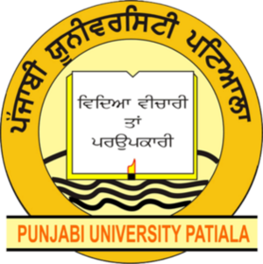
PRESENTATION ON
INDUSTRIAL SUMMER TRAINING AND PROJECT
DEPARTMENT OF ELECTRONICS AND COMMUNICATION ENGINEERING PUNJABI UNIVERSITY, PATIALA
Presented By:
Name-Himanshu Saini
Roll No.-12302052
Class (Branch):B.Tech ECE

Slide 2

INTRODUCTION TO ORGANISATION
Future Finders is an upcoming and upgrowing organization improvising ‘State of the art’ skill development courses to the aspirants who wish to build up their career in the field of web development, web Designing, and many more fields. At Future Finders, we offer services to the students, who are on the brink of entering into corporate Rena an incredible opportunity to transform one’s career in the technical Sector.
Our team of professional and expert developers and designers fully focus on practical experience, thereby equipping one with the essential skills required in IT arena now a days in various disciplines including Software, Cloud, Data, and QA Engineering.

Slide 3


TECHNOLOGY LEARNED
Proteus 8 Professional
Proteus is an Electronic Design Automation (EDA) software suite developed by Lab center Electronics. It is widely used for designing, simulating, and laying out Printed Circuit Boards (PCBs). The software integrates several tools to facilitate the entire electronic design process, from schematic capture to final PCB production.
KiCad
KiCad is a free and open-source electronic design automation (EDA) suite for creating schematics and printed circuit boards (PCBs). It offers a comprehensive toolset for professional and hobbyist use, including schematic capture, PCB layout, integrated circuit simulation, and 3D rendering. Key features include its cross-platform compatibility (Linux, macOS, Windows), robust libraries, and continuous development by a dedicated team, notes KiCad's official documentation.

Slide 4

TECHNOLOGY LEARNED
Arduino IDE
The Arduino IDE is a free, open-source software application that allows users to write, compile, and upload code to Arduino boards. It simplifies the process of programming microcontroller boards like the Arduino Uno by providing a text editor for writing code, a compiler to convert it into a format the board understands, and a serial monitor to communicate with the board. Available for Windows, macOS, and Linux, its key features include syntax highlighting, an auto-formatter, library management, and a user-friendly interface designed for both beginners and experienced users.

Slide 5
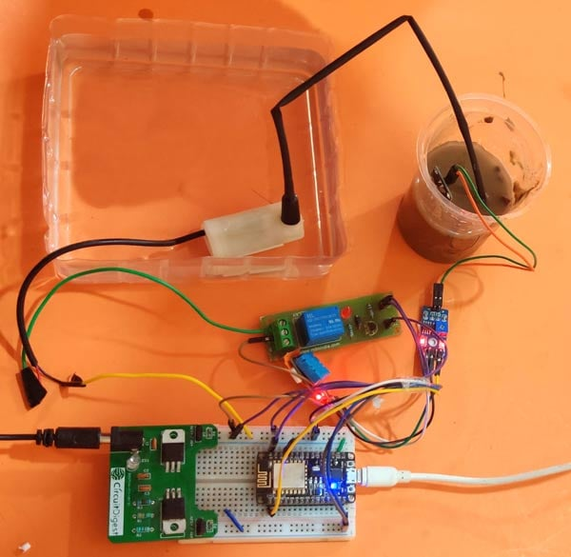
INTRODUCTION TO PROJECT
The proposed system has been designed to overcome the unnecessary water flow into the agricultural lands. Temperature, moisture and humidity readings are continuously monitored by using temperature, moisture and humidity sensor and send these values to the assigned IP address. Android application continuously collects the data from that assigned IP address. Once the soil moisture values are exceeded the particular limit then the relay, which is connected to the Arduino microcontroller controls the motor. The android application is a simple menu driven application, with 4 options. This includes motor status, moisture, temperature and humidity values. The motor status indicates the current status of the pump.

Slide 6
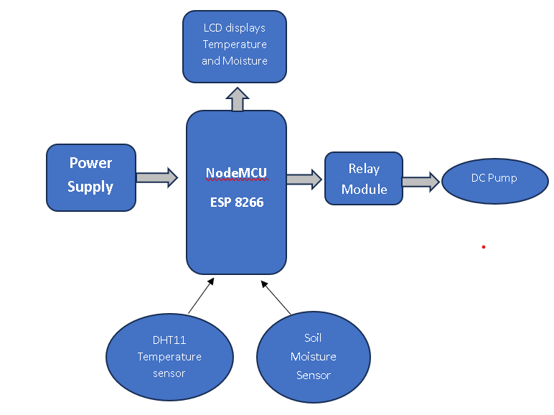
BLOCK DIAGRAM OF PROJECT

Slide 7
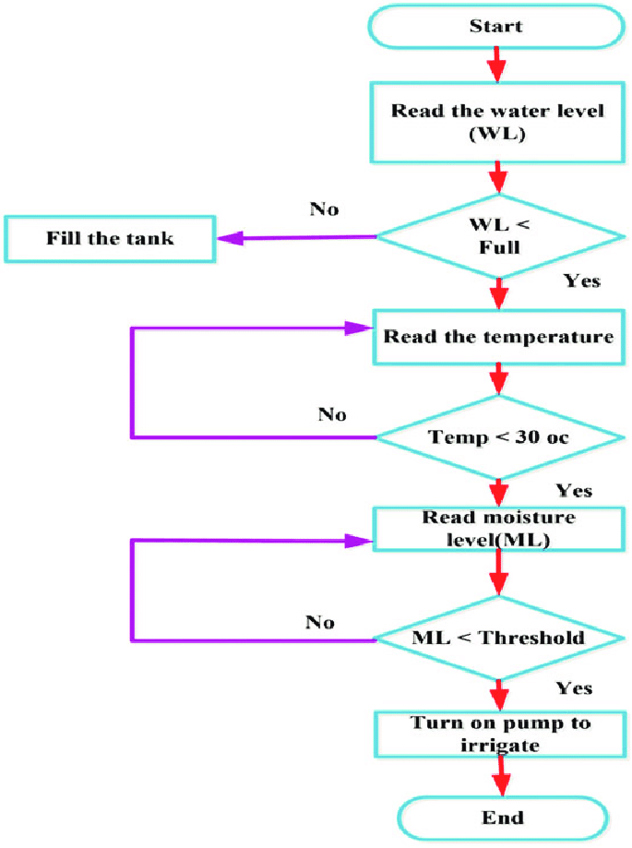
FLOW CHART OF PROJECT

Slide 8
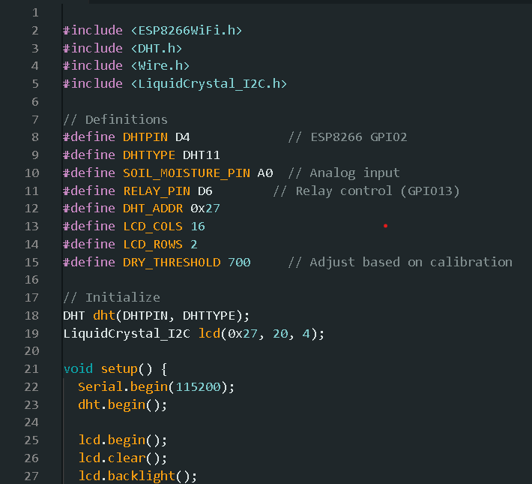
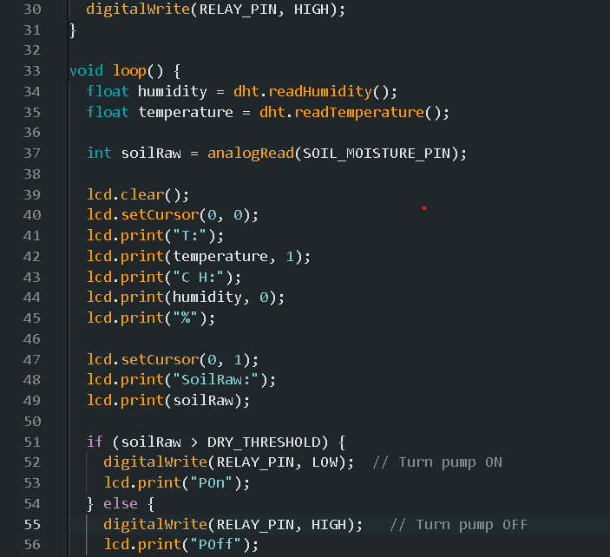
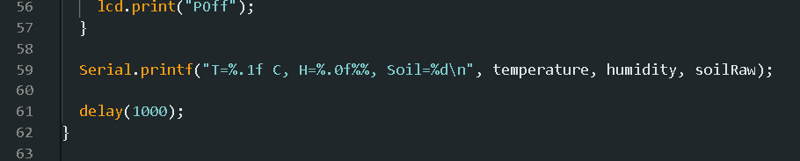
CODING OR WORKING OF PROJECT

Slide 9
SCREENSHOTS

Slide 10
APPLICATIONS
Automated, condition-based irrigation: The system uses soil moisture sensors to check water levels and the NodeMCU turns the water pump on only when the moisture drops below a user-defined threshold. This prevents over-watering and water waste, especially in areas with fluctuating rainfall.
Remote monitoring and control: The NodeMCU's built-in Wi-Fi allows it to send sensor data to a cloud platform like ThingSpeak or a custom mobile application (e.g., using Blynk). Users can then view real-time data, such as soil moisture, temperature, and humidity, and manually turn the pump on or off from their phone.
Enhanced plant health and yield: By maintaining optimal moisture levels and providing data on other environmental factors, the system helps ensure healthier plant growth and higher crop yields. For example, one study showed improved growth in coffee seedlings using a similar system, as noted on ResearchGate.
Intelligent water management: The system can also incorporate a rain sensor to stop irrigation during rainfall, further conserving water. Additionally, some advanced applications might include a flow meter to track the exact amount of water being used, providing even greater control and data for optimization.
Security and theft prevention: By adding a PIR (Passive Infrared) motion sensor, the system can detect unauthorized movement in the monitored area. The system can then send an alert to the user, helping to deter pests or prevent theft.
Cost and labor reduction: Automation significantly reduces the need for manual labor in monitoring and watering fields, which is particularly beneficial for large farms where manual inspection is difficult. The system is also cost-effective, especially in regions with limited resources, by reducing water and electricity consumption.
Customizable for various applications: The modular nature of the system makes it adaptable to different scales, from a simple self-watering pot to a large-scale agricultural field. It can be programmed for different plant types and soil conditions, ensuring appropriate watering schedules.

Slide 11
REFERENCES
1. https://futurefinders.in/services/
2. https://www.geeksforgeeks.org/electronics-engineering/what-is-vlsi/
3. https://x.com/Mahmud_Ibrahiem/status/1504402049391370246
4. https://randomnerdtutorials.com/esp8266-pinout-reference-gpios/
5. https://en.wikipedia.org/wiki/Arduino_Uno
6. https://circuitdigest.com/tutorial/different-types-of-sensors-and-their-working
7. https://www.arduino.cc/en/Guide/Introduction
8. https://srituhobby.com/smart-irrigation-system-using-nodemcu-and-blynk/?srsltid=AfmBOopiigBYuHoK7a2-yw6nyqU5xr1tJ3RIdIV6swUPaeTQGXC9p9Bv
9. https://harishprojects.com/products/dht-11-dht11-digital-temperature-and-relative-humidity-sensor-module?srsltid=AfmBOorpYLnTVK_7Yj-ijXNnqqdTVK9EueMspAgBDCfDZEK
10. https://www.researchgate.net/figure/Flowchart-of-the-smart-automatic-irrigation-system_fig2_334638910

Slide 12
THANK YOU

